Slide 1


Mechanical Work

Slide 2
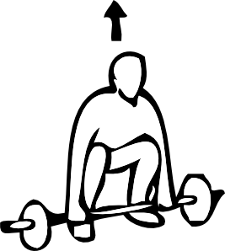
What is Work?
Mechanical work occurs when a force (or a component of a force) displaces an object
It is a scalar quantity measured in joules
1 J = 1 N⋅m
Notes:
Where 1 joule is the amount of work done by 1 force being applied through 1 m in the same direction of the force

Slide 3
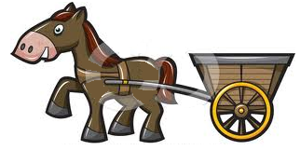
Mechanical Work: Case 1
If an applied force is in the SAME DIRECTION as the displacement:
Example:
Calculate the work done by the horse.
Assume no friction.
F = 35 N
∆d = 12 m
Notes:
If the force is parallel to the displacement, we can calculate the magnitude of the work by multiplying the two values
This problem can become more complex by requiring you to calculate the displacement using the kinematics equations
Can also determine proportionality statements from this equation

Slide 4
Example
Calculate the work done by the horse if it now applies a force of 35 N to accelerate the cart from rest, to a velocity of 8.0 m/s [forward] in 3.5 s.
F = 35 N
∆d = ?
Notes:
If the force is parallel to the displacement, we can calculate the magnitude of the work by multiplying the two values
This problem can become more complex by requiring you to calculate the displacement using the kinematics equations

Slide 5
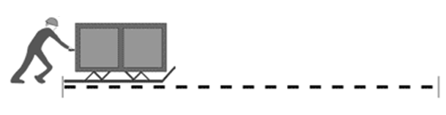
Mechanical Work: Case 2
If only PART of the applied force is in the direction as the displacement:
∆d
Stop to think…
What is the purpose of the “cosθ” term?
What does this imply about the direction of the force?
Notes:
Where F is the applied force, and theta is the angle between the force and the displacement (thus Fcos(theta)) calculates the component of the force in the direction of the displacement
In your future math studies you will learn that this is the ‘dot product’ between these two vectors

Slide 6

Example
Calculate the work done by the mover in the following situation:
55 N
∆d = 8.5 m

Slide 7

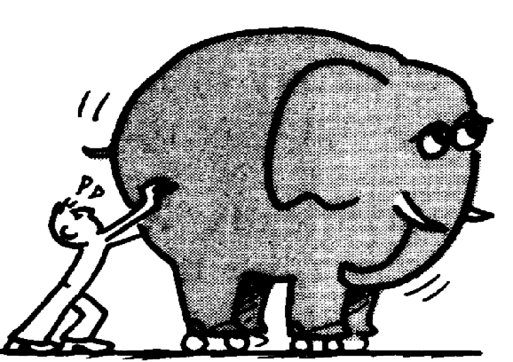
Special Cases:
1. Zero Work occurs if:
There is no applied force
… or … There is no displacement
… or … The applied force is perpendicular to the displacement

Slide 8
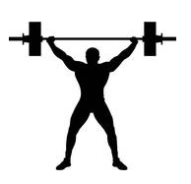
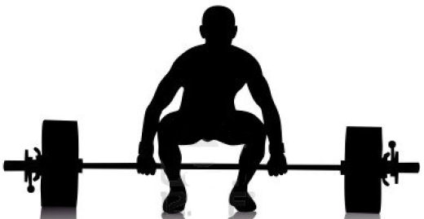
Special Cases:
2. Negative Work:
Occurs when a force is applied in the opposite direction of the displacement
m = 91 kg
∆d = 2.3 m
Calculate the work done by:
Gravity
The weightlifter

Slide 9
Special Cases:
3. Total (net) Work on an object is the sum of the individual work values.
m = 91 kg
∆d = 2.3 m
Calculate the total (or net) work done on the weight.

Slide 10
Think Pair Share…
Explain whether or not work is being done if:
…a person at rest holds a parcel?
…a person glides on skis holding a parcel?
…a space capsule drifts far out in space at a constant velocity?
Notes:
Follow up: what is doing the work? Is it positive or negative? Explain

Slide 11
Think Pair Share…
Explain whether or not work is being done if:
…you lift a package vertically.
…you push a box on a rough surface.
Notes:
Follow up: what is doing the work? Is it positive or negative? Explain

Slide 12
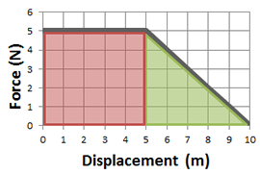
What If Work Isn’t Constant?
The work done on an object may be represented by the AREA under a force-displacement graph
This yields the same formula as before when force is constant, but also allows us the opportunity to work with varying forces
Notes:
Constant applied force: 0 s – 5 s
Changing applied force: 5 s – 10 s (negative force)

Slide 13


